Slide 1





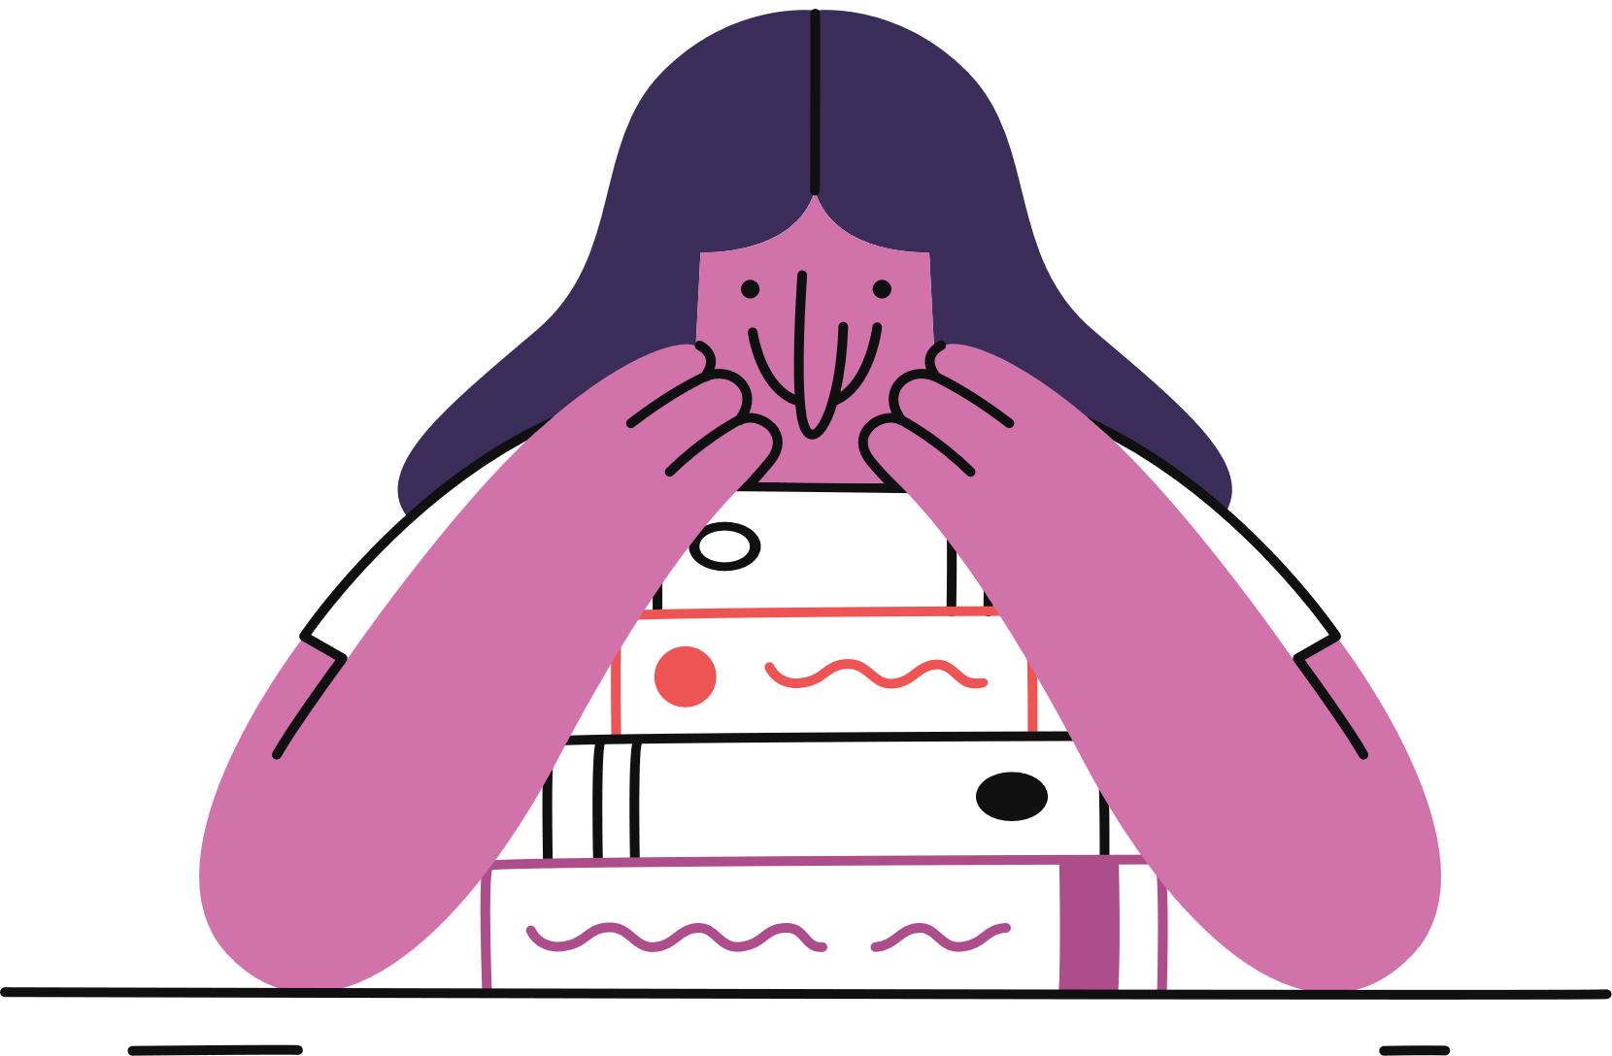
verbs
Grammar Handbook
SENTENCE COMPLETION
adverbs
nouns
PEV113

Slide 2










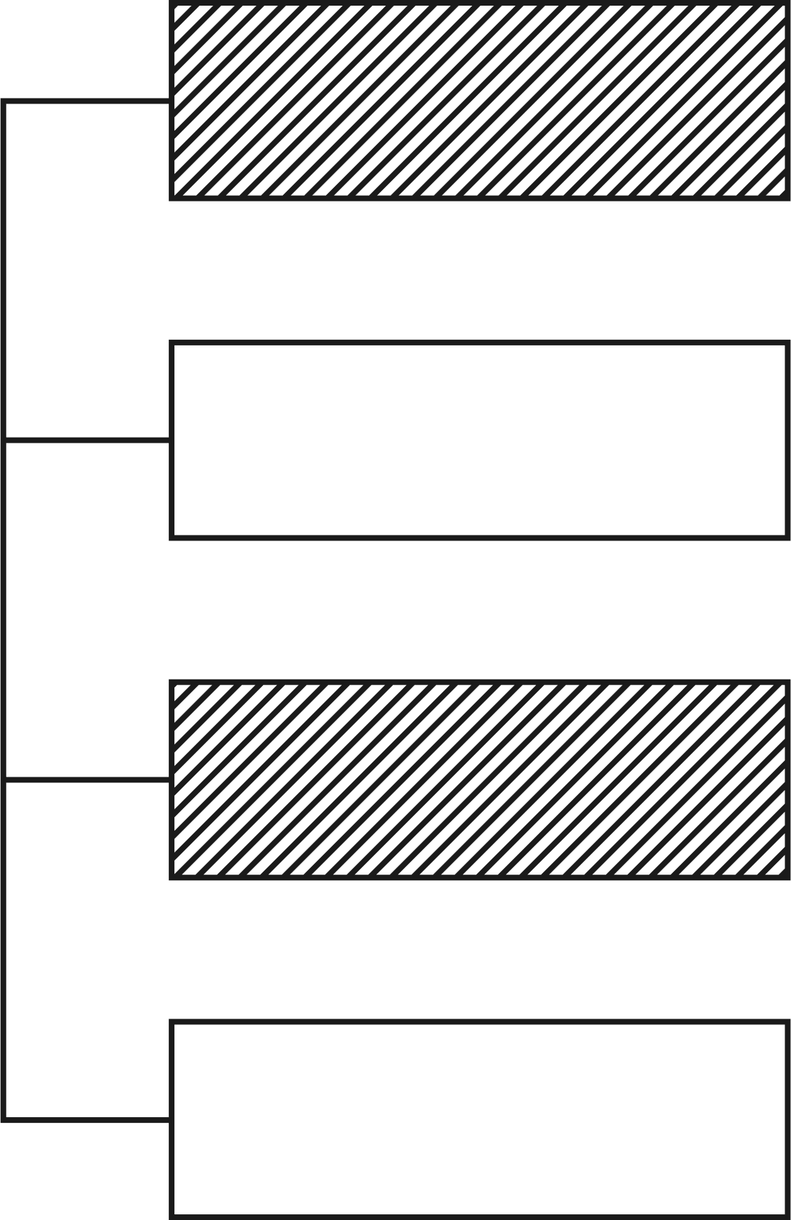
Restatement
Eliminating options on verbal clues
TYPES
Comparison
Verbal hints are included in a sentence or passage that helps the reader to determine the correct option to complete a sentence. Hints can be of the following types:
Contrast
Cause and Effect

Slide 3

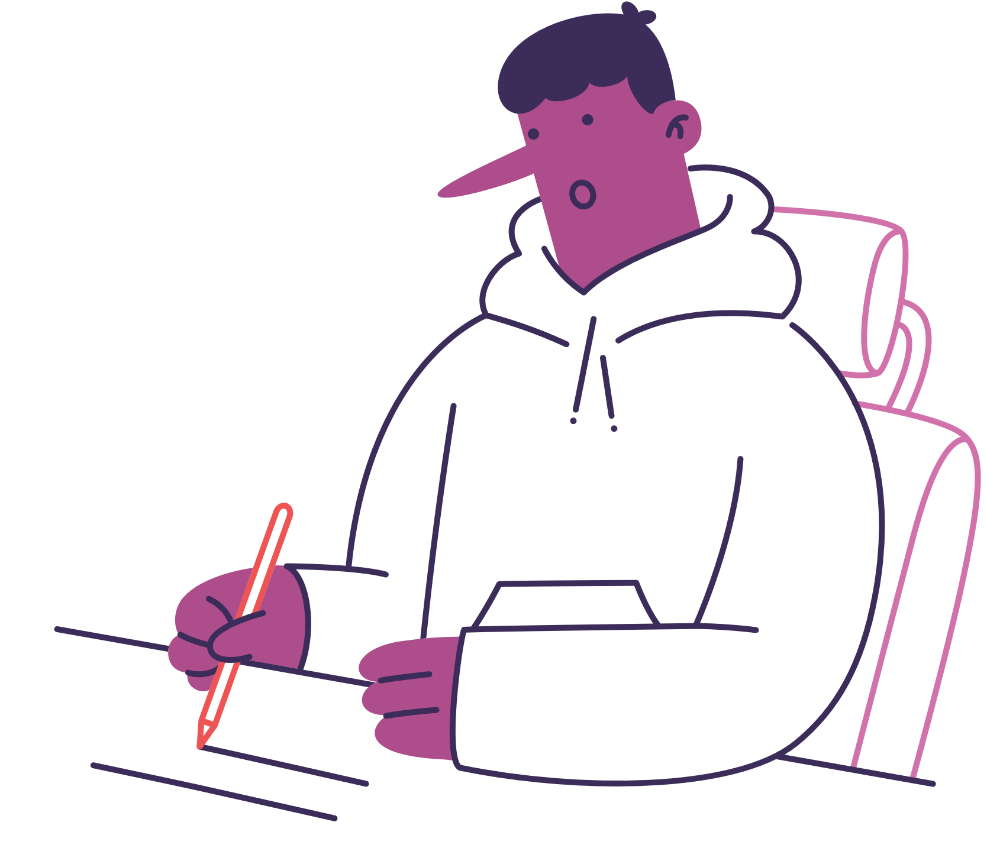

Restatement
Containing words such as namely, in other words, in fact, that is, etc.
For example, in the sentence “ The pickpocket was a trickster, in other words, a ___________.”
Here answer will be knave or scoundrel, which restates “trickster

Slide 4



2. Comparison
Containing words such as likewise, similarly, just as, etc.
For example, in the sentence “ Jack was cleared of all charges; similarly, Jill was______. “
Here we have to compare ‘cleared of all charges’ with the suitable word, and hence vindicated is the answer

Slide 5
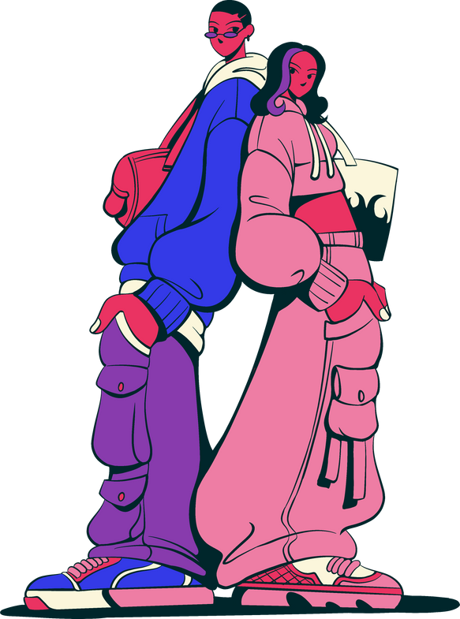


3. Contrast
Containing the words such as though, although, however, despite, but, yet, on the other hand, but, however, despite, or, on the contrary, etc.
For example, in the sentence “ Although the tiger is a solitary beast, its cousin the lion is a wild ___________ animal. “
Here answer should be in contrast with “solitary”. Therefore, gregarious or sociable are possible answers.

Slide 6




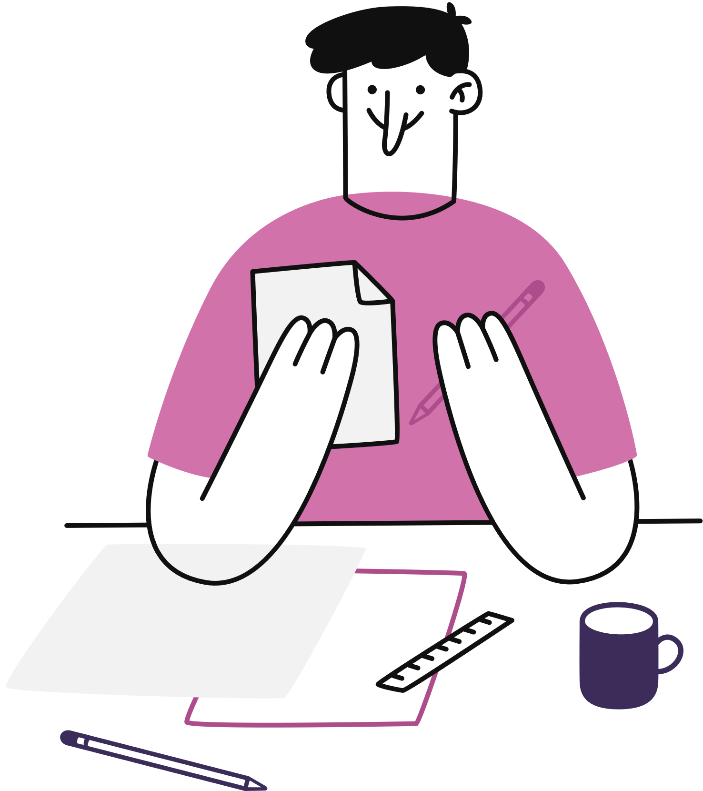
4. Cause and Effect
Containing words such as this, therefore, consequently, because of, etc. Also contains phrases such as due to, as a result, leads to, etc.
For example, in the sentence “ A truck stole her parking spot; consequently, Rocky’s ___________ look showed her displeasure.
Here answer should be to find the cause for someone to steal. Therefore answer may be scowling or sullen.

Slide 7


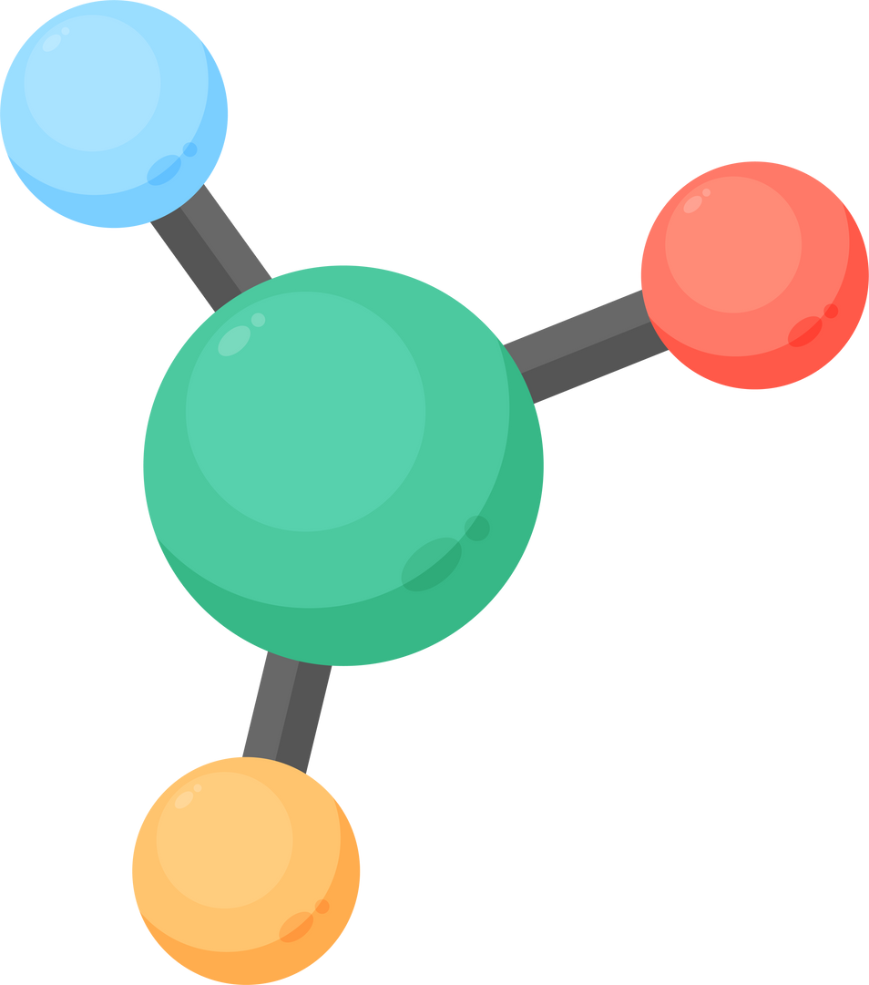

Strategies
Read the sentence properly
Look for Hints and context clues
Pluses and Minuses of word clues
Check for structure words

Slide 8


Strategies
Visualize the context
Use the process of elimination
Work backwards for double blanks

Slide 9
Let’s Practice
sentence
Add a little bit of body text
Sentence Completion based on Vocabuary
1. The two brothers look so _________ that it is difficult differentiate them.
a. same
b. similar
c. identical
d. alike
completion

Slide 10



adj.
Let’s Practice- Answers
Alike --- Identical options, thus use sentence structure rules and process of elimination to find the right answer
nouns

Slide 11
Let’s Practice
sentence
Add a little bit of body text
2. My friend has good __________ over English and Hindi.
a. authority
b. command
c. expertise
d. hold
Sentence Completion based on Vocabuary
completion

Slide 12
adj.
Let’s Practice- Answers
2. Command --- Identical options, thus use sentence structure rules and process of elimination to find the right answer
nouns

Slide 13
Let’s Practice
sentence
Add a little bit of body text
Sentence Completion based on Vocabuary
3. Every week, in the office, one hour is __________ to games and sports.
a. conferred
b. dedicated
c. conceded
d. devoted
completion

Slide 14
adj.
Let’s Practice- Answers
3. Devoted--- Identical options, thus use appropriate meaning, sentence structure rules and process of elimination to find the right answer
nouns

Slide 15
Let’s Practice
sentence
Add a little bit of body text
Sentence Completion based on Vocabuary
4. Suresh’s skin was ______ to burn if he spent too much time in the sun.
(a) Prone
(b) Eminent
(c) Erect
(d) Daunted
completion

Slide 16
adj.
Let’s Practice- Answers
4. Prone is the correct answer which is an adjective. Its meaning is – a tendency or inclination to something.
nouns

Slide 17
Let’s Practice
sentence
Add a little bit of body text
Sentence Completion based on Vocabuary
5. The Security officer ______ the crowd to step back from the fire to avoid any mis happening.
(a) Undulated
(b) Enjoined
(c) Stagnated
(d) Delineated
completion

Slide 18
adj.
Let’s Practice- Answers
5. Enjoined is the correct answer which is a verb. Its meaning is to issue an order or command with authority.
nouns

Slide 19
Let’s Practice
sentence
Add a little bit of body text
Sentence Completion based on Vocabuary
6. As a result of the _________ storm, some homes were shattered.
(a) Severe
(b) Facile
(c) Temperate
(d) Amenable
completion

Slide 20
adj.
Let’s Practice- Answers
6. Severe is the correct answer which is an adjective. Its meaning is - something that is intense or harsh
nouns

Slide 21
Let’s Practice
sentence
Add a little bit of body text
Sentence completion based on parts of speech
1._________his parents had little money, peter was obliged to his uncle for paying for his college education.
a) Since
b) For
c) Though
d) Even if
completion

Slide 22
adj.
Let’s Practice- Answers
Since
nouns

Slide 23
Let’s Practice
sentence
Add a little bit of body text
Sentence Completion based on Vocabuary
2. ___________ studying for hours, he still failed the test.
a) Thus
b) Because
c) Despite
d) Although
completion

Slide 24
adj.
Let’s Practice- Answers
2. Despite
nouns

Slide 25
Let’s Practice
sentence
Add a little bit of body text
Sentence Completion based on Vocabuary
3. She arrived at the airport __________ in time to catch her flight.
a) before
b) after
c) just
d) with
completion

Slide 26
adj.
Let’s Practice- Answers
3. Just
nouns

Slide 27
Let’s Practice
sentence
Add a little bit of body text
Due to the ______ of new media technology, many people predict newspapers will soon be ______ .
A. rise, obsolete
B. increase, ubiquitous
C. prevalence, commonplace
D. incline, widespread
Sentence completion - double blank
completion

Slide 28
adj.
Let’s Practice- Answers
A. rise, obsolete
nouns

Slide 29
sentence
Let’s Practice
2. The ______ of meat in your refrigerator doesn’t necessarily indicate that you are______.
A. presence, herbivorous
B. absence, vegetarian
C. amount, omnivorous
D. color, carnivorous
Add a little bit of body text
Sentence completion - double blank
completion

Slide 30
adj.
Let’s Practice- Answers
2. A. presence, herbivorous
nouns

Slide 31
clues
Grammar Handbook
Thank You
tone
blanks

